Slide 1

Cogs 108 – data science in practice (dr. brad voytek)
Enlin Wei
Sections A01 & A04
(Mondays & fridays 2pm-3pm)

Slide 2
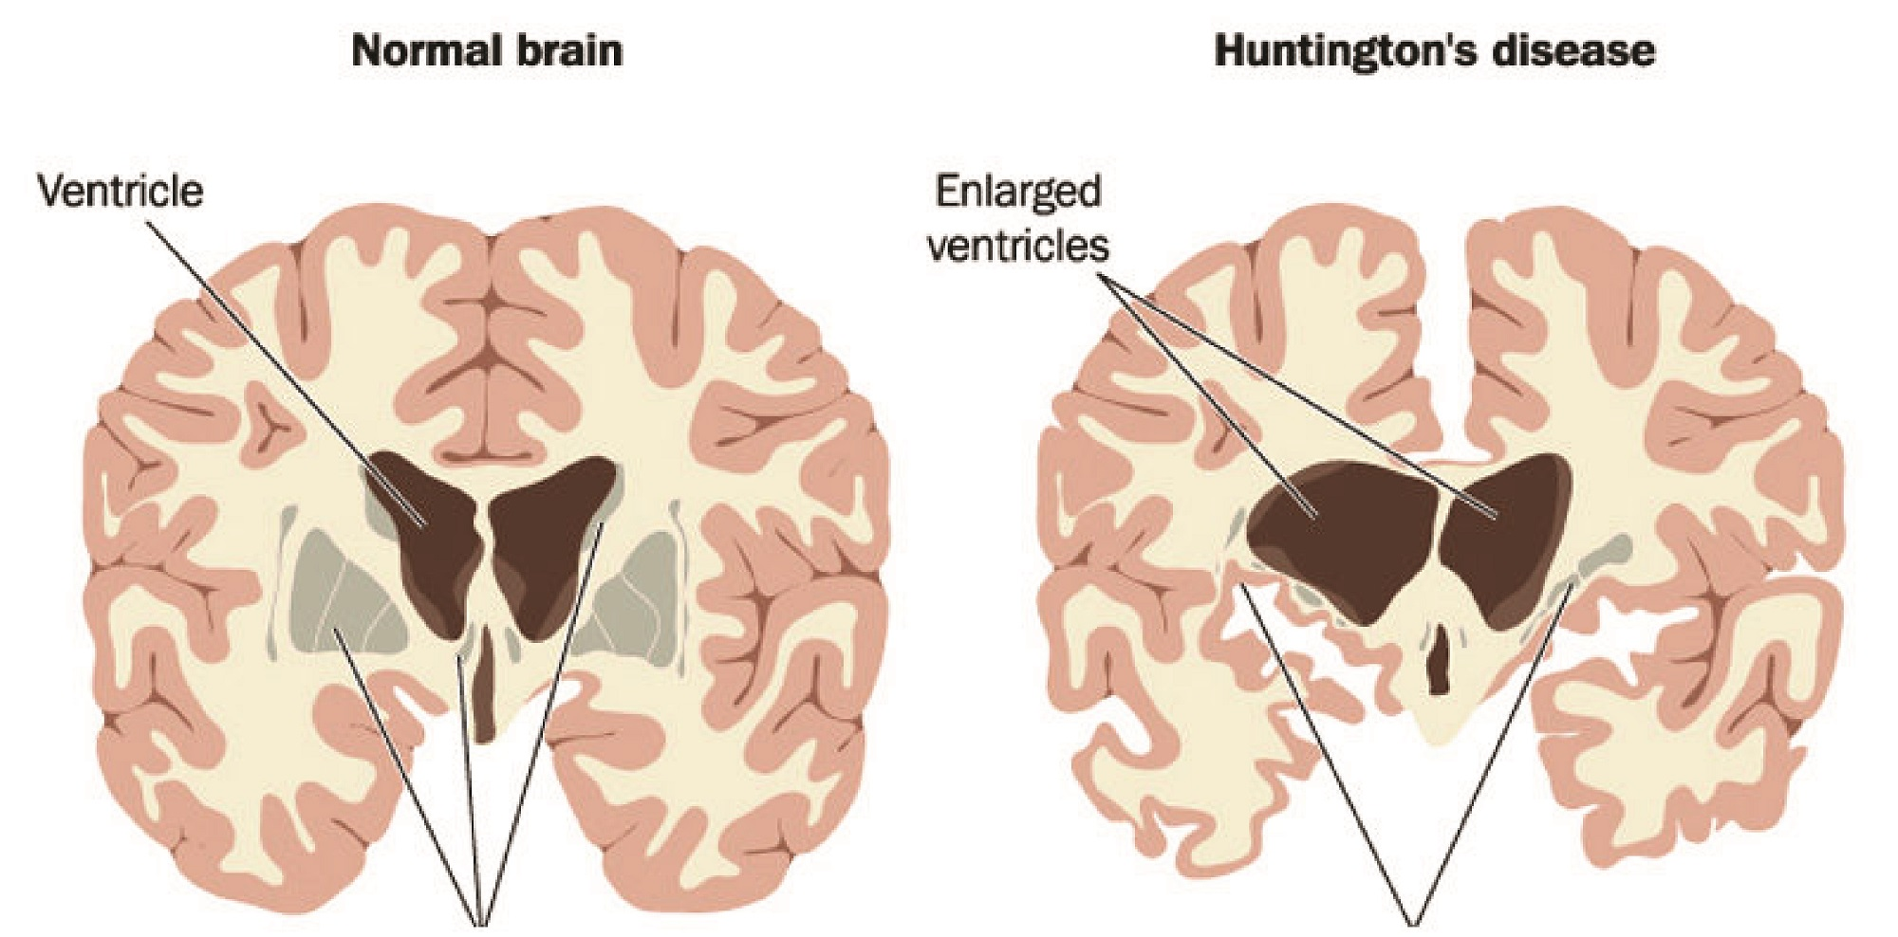


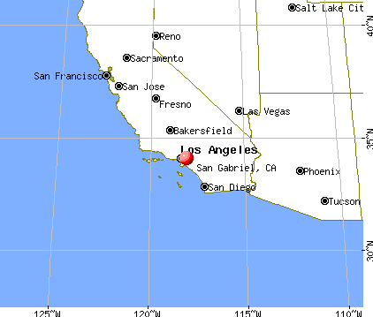



About me
Notes:
I’m a graduate student studying Huntington’s Disease, a genetic condition that causes neurodegeneration of the brain as the patient ages. I will be researching how genetic mutations that cause HD affect the huntingtin protein’s interactions with other proteins in the brain, and how those interactions might cause neurodegeneration.
I’m from a city called San Gabriel, which is in an area called San Gabriel Valley that’s east of LA (but still part of LA county). It’s also known by its area code “626” because of 626 Night Market.
In my free time, I like watching some Chinese reality shows, and I also help out with my church org’s international groups, IGSM and IUSM (they stand for international graduate and undergraduate student ministries, respectively).

Slide 3
about you guys
Notes:
What are you guys’s names, colleges, and majors?

Slide 4
Today…
Set up Python
Set up Datahub

Slide 5


Set up python 3.7
Install Anaconda Navigator (choose Python 3.7 version)
https://www.youtube.com/watch?v=T3ff57rxTa8 (Windows)

Slide 6

Set up datahub
Go to Datahub
Log in with UCSD credentials

